Slide 1
BABY CARE
Guided by, Submitted by,
Prof : Jogimol Joseph Archana m k
Assistant professor, Reg no:MCK22-MCA2009
MCA Department

Slide 2
ABSTRACT
Digitizing manual processes for ASHA workers.
Simplifying work through this web interface.
Registering workers and assigning locations.
Monitor the health of both mother and baby.
Track nutrition for children under 5.
Improve child health through timely alerts.
Enhance maternal and child nutrition management.

Slide 3
INTRODUCTION
Entire manual process of Asha workers work online.
It is very important for child upto 5years.
Asha worker not bother about child’s & mothers.
Users & Asha workers can access these website at anywhere.
No formal knowledge is needed for use this system
Empowers government & users,facilitating secure & rapid access.

Slide 4
MODULE DESCRIPTION
Admin
Registration Module
View Vaccination Details
View Food Details
View Disease Details
View Details of parent and child
View Tips

Slide 5
Worker
Add Mothers
Add Vaccination Details
Alert Vaccination Dates to parents
Add Food Details
Add Disease Details
Add Health Care Details
Distribute Food
Add Basic Tips To care child

Slide 6
Mother
View Vaccination Details
View Food Details
View Disease Details
View Health Care Tips
Distribution Food Details
View tips

Slide 7
SYSTEM ANALYSIS
EXISTING STSTEM
There is no way to alert mothers about vaccination details or food details .
Egg: pulse polio vaccination.
It is very important for child up to 5 years.
There is no way to alert food details for children and pregnant.
The new Panchayath programs, health center programs & Government schemes are unavailable to public.
The Asha worker not bother about new born child’s and mothers.

Slide 8
PROPOSED SYSTEM
.
The Government add Panchayath & publish all schemes & view all reports of Panchayath .e.g: Maternity Benefit Programme
Asha workers & Users can view these schemes through website.
Panchayath are managed by admin can view report by district wise.
Panchayath add all programs conduct by panchayath .
Asha’s worker informs relevant user’s availability of food, vaccination & program conducting details.
Asha’s worker & mother can access these websites at anywhere.

Slide 9
HARDWARE SPECIFICATION
MACHINE : INTEL DUAL
CORE MOTHER BOARD : INTEL 945
CHIPSET MEMORY : 4 GB
HARD DISK : 500 GB
MONITOR : 18.5” LED MONITOR
KEYBOARD : USB/3
MOUSE : USB/

Slide 10
SOFTWARE SPECIFICATION
Operating system : Windows
Web technologies : python, Django, html, CSS
Database : MySQL
Web browser : Google Chrome/Mozilla Firefox

Slide 11
Literature review
Slno: | Paper Title | Author | Year of Publishing | Advantage | Disadvantage
1 | India’s Baby care Market | Nisha Nandal,Dr.Ritika Malik,Dr.Nveen Nandal. | 2017 | Government can view all reports of Panchayaths. | Functions increased the complexity of the punchayath.
2 | Child care Decision Making | Nicole Forry,Kthryn Tout,collen vesely | 2013 | To support the provision of expert consultation assesment and analysis in child care. | Government schemes are unavailable to public.

Slide 12
Slno: | Paper Title | Author | Year of Publishing | Advantage | Disadvantage
3 | Access to high quality care for infants and toddlers | Tamara Halle,Tiffyany Bamdad,Maya Cook | 2009 | Children experience the most rapid rate of development during the first three years of life. | The Asha worker not bother about new born child’s and mothers.

Slide 13
Slno: | Paper Title | Author | Year of Publishing | Advantage | Disadvantage
4 | Child Health | Dr.Fehmida jalil | 1997 | Beliefs and practices related to childhood illnesses. | Health center programs and Government schemes are unavailable to public.

Slide 14
Slno: | Paper Title | Author | Year of Publishing | Advantage | Disadvantage
5 | Contribution to good practices in child care | Dr.Bras Enferm | 2018 | To identify scientific evidence on the contribution of nurse work to good practices in child care . | The drawbacks of the existing system as listed before are fully evacuated.

Slide 15
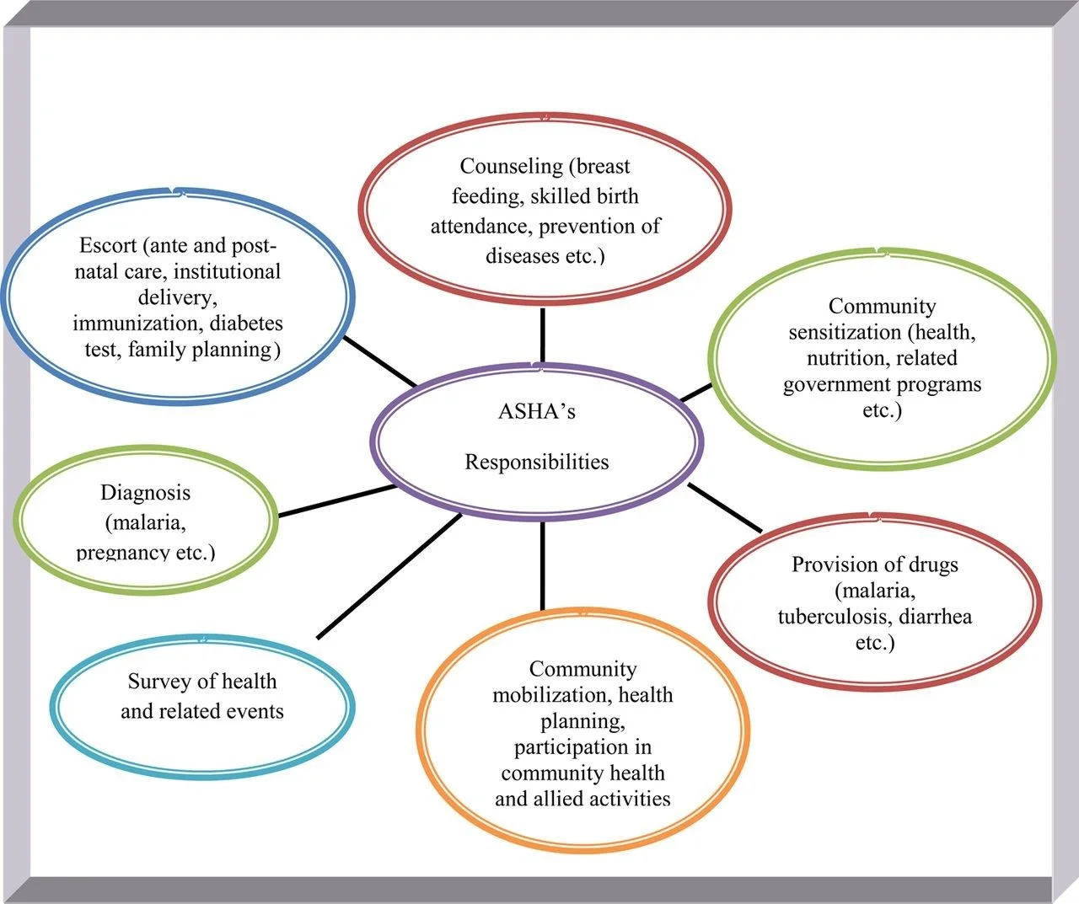
System Architecture

Slide 16
OBJECT DIAGRAM
worker
wrkr_id:Megha
worker_name:megha
email:megha@gmail.com
Mother
Mother_id:3
Name:bindu
Ward_no:10
Doctor
Doctot_id:Dr.manu
Address:aluva
Place:Aluva
Vaccination
Vac_id:1
Wrkr_id:2
Vac_name:polio
Location:panchayath office

Slide 17
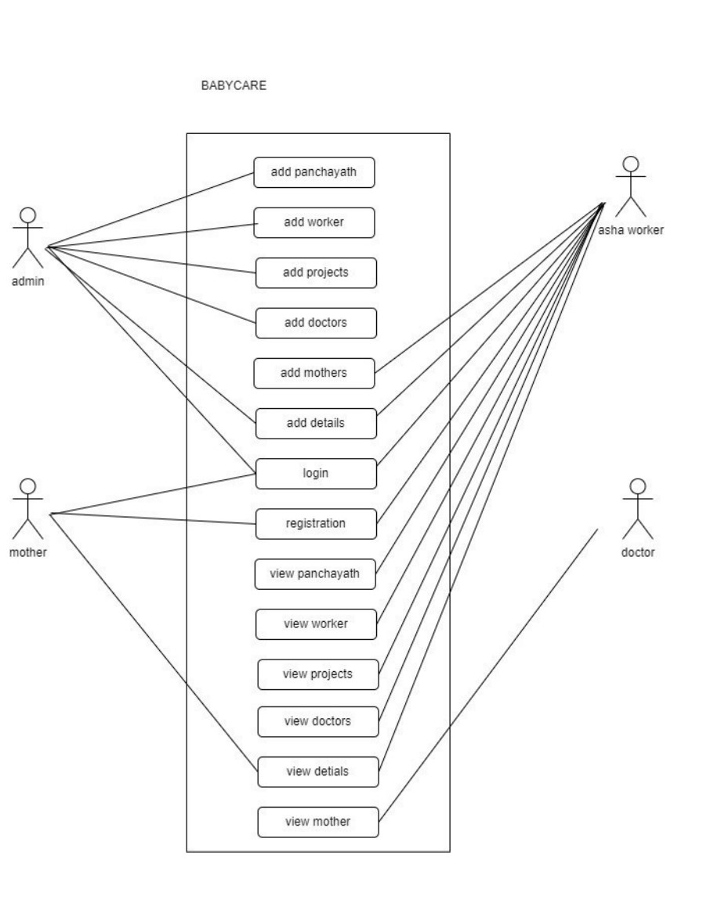
Use case Diagram

Slide 18
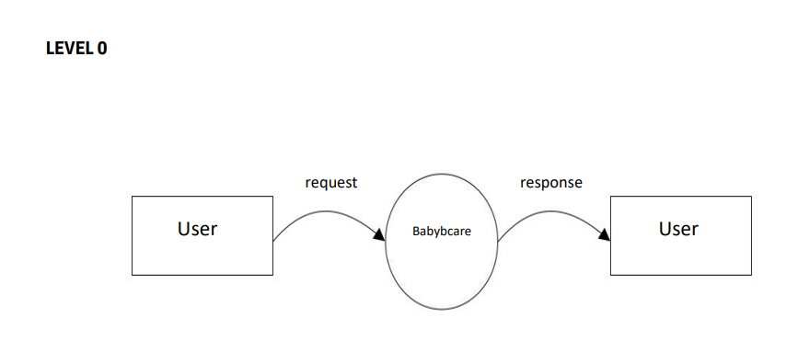
DATA FLOW DIAGRAM
Level 0

Slide 19
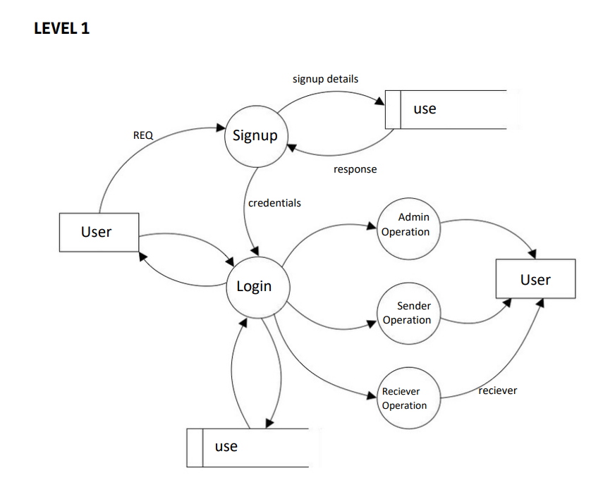

Slide 20
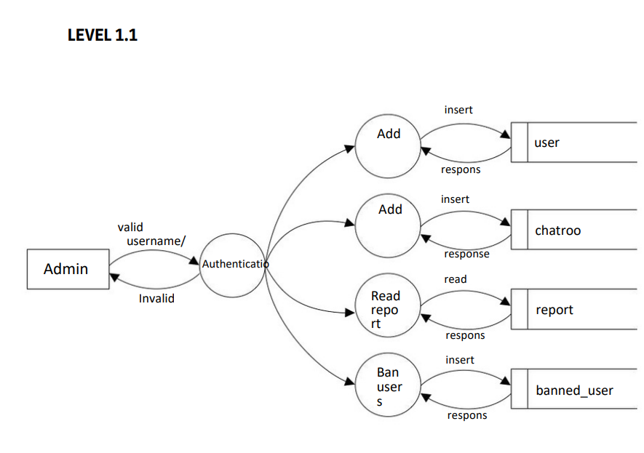

Slide 21
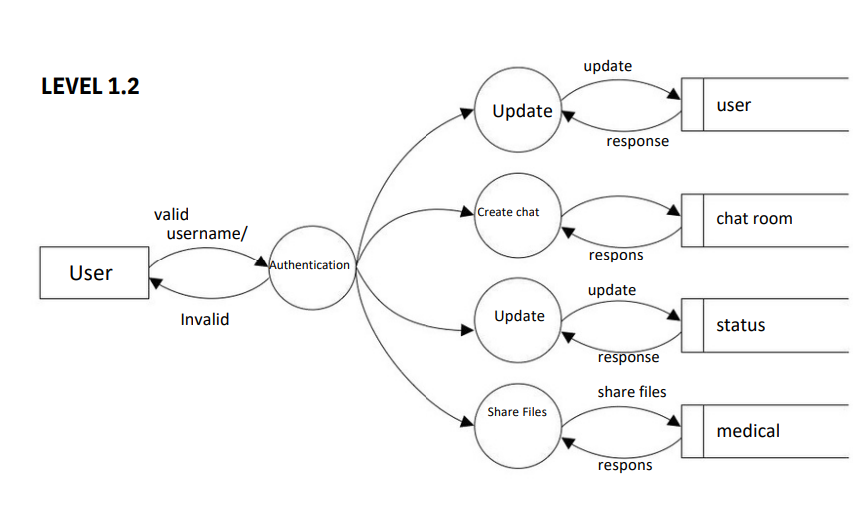

Slide 22
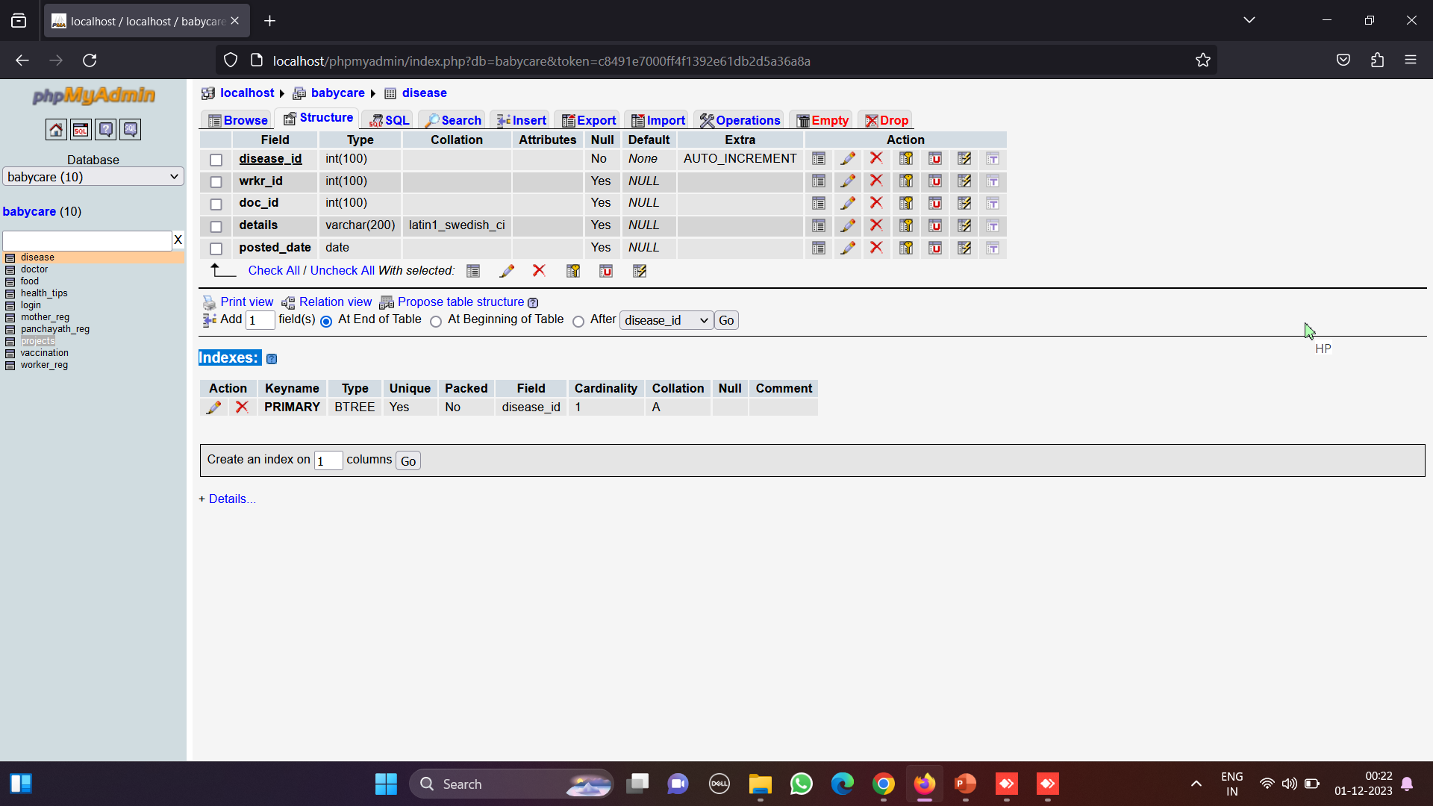
TABLE DESIGHN 1.Table name:disease

Slide 23
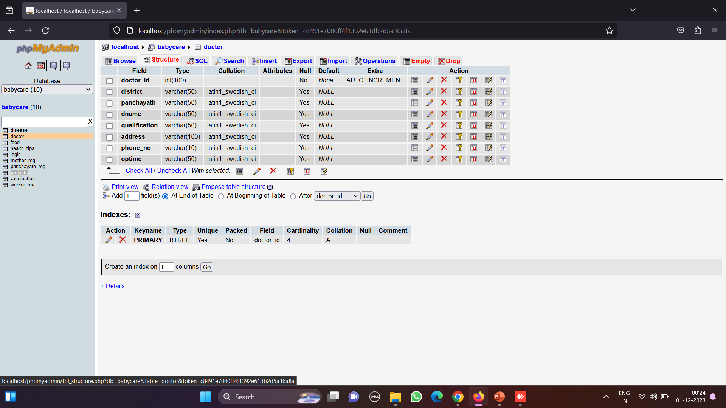
2.Table name:doctor

Slide 24
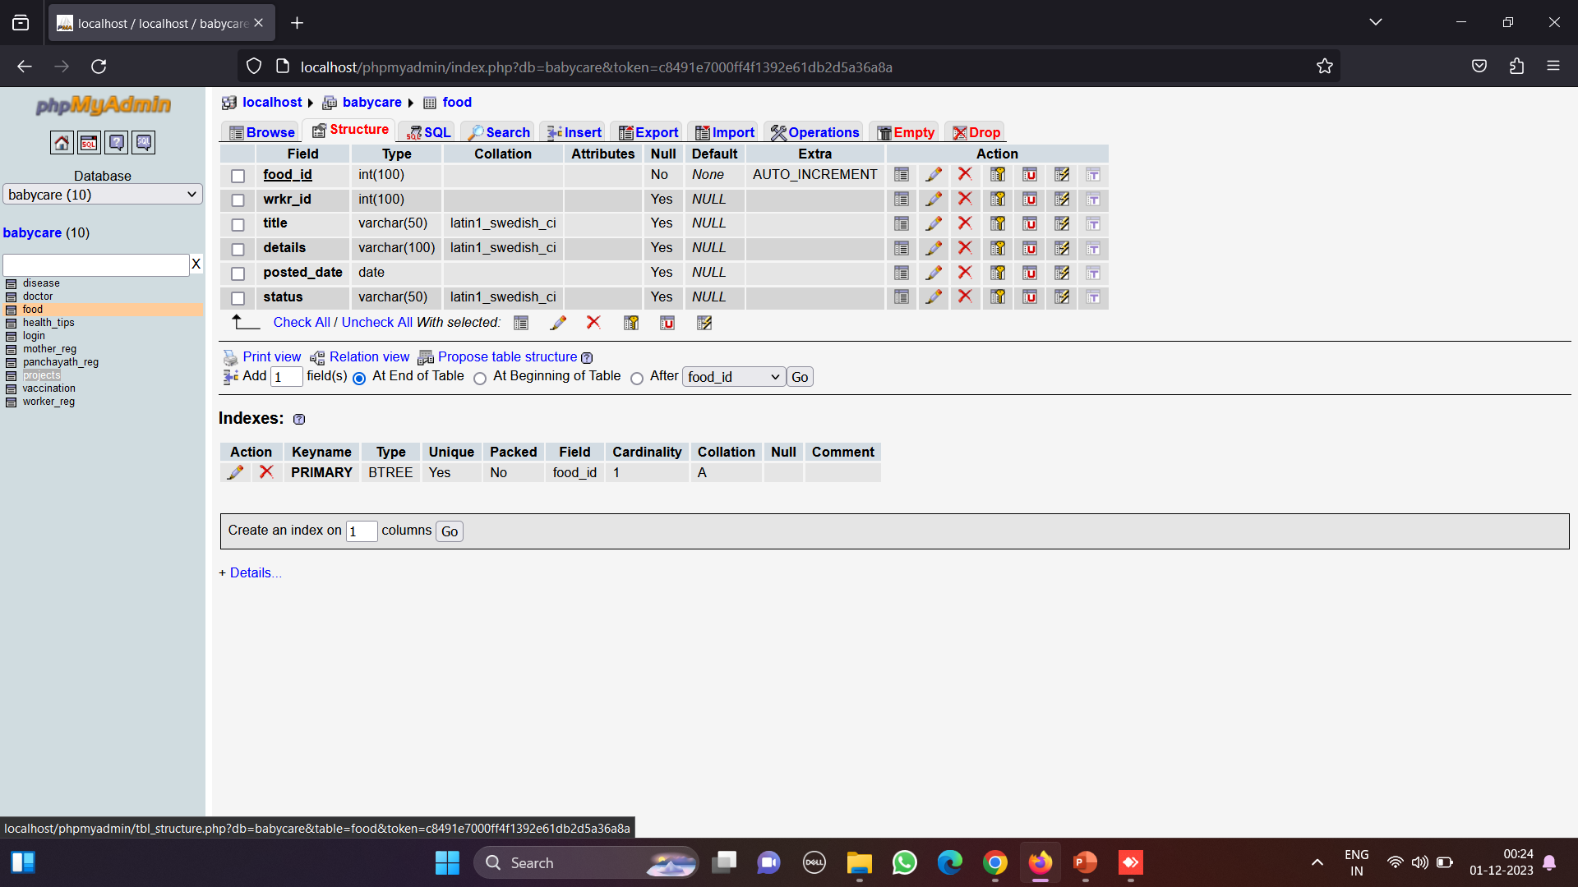
3.Table name:food

Slide 25
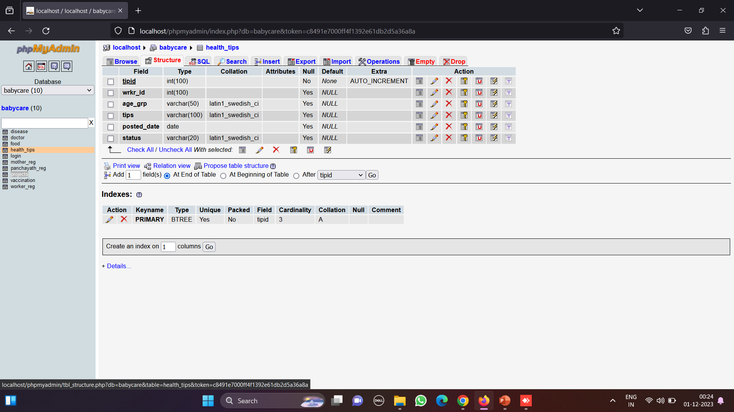
4.Table name:health_tips

Slide 26

5.Table name:login

Slide 27
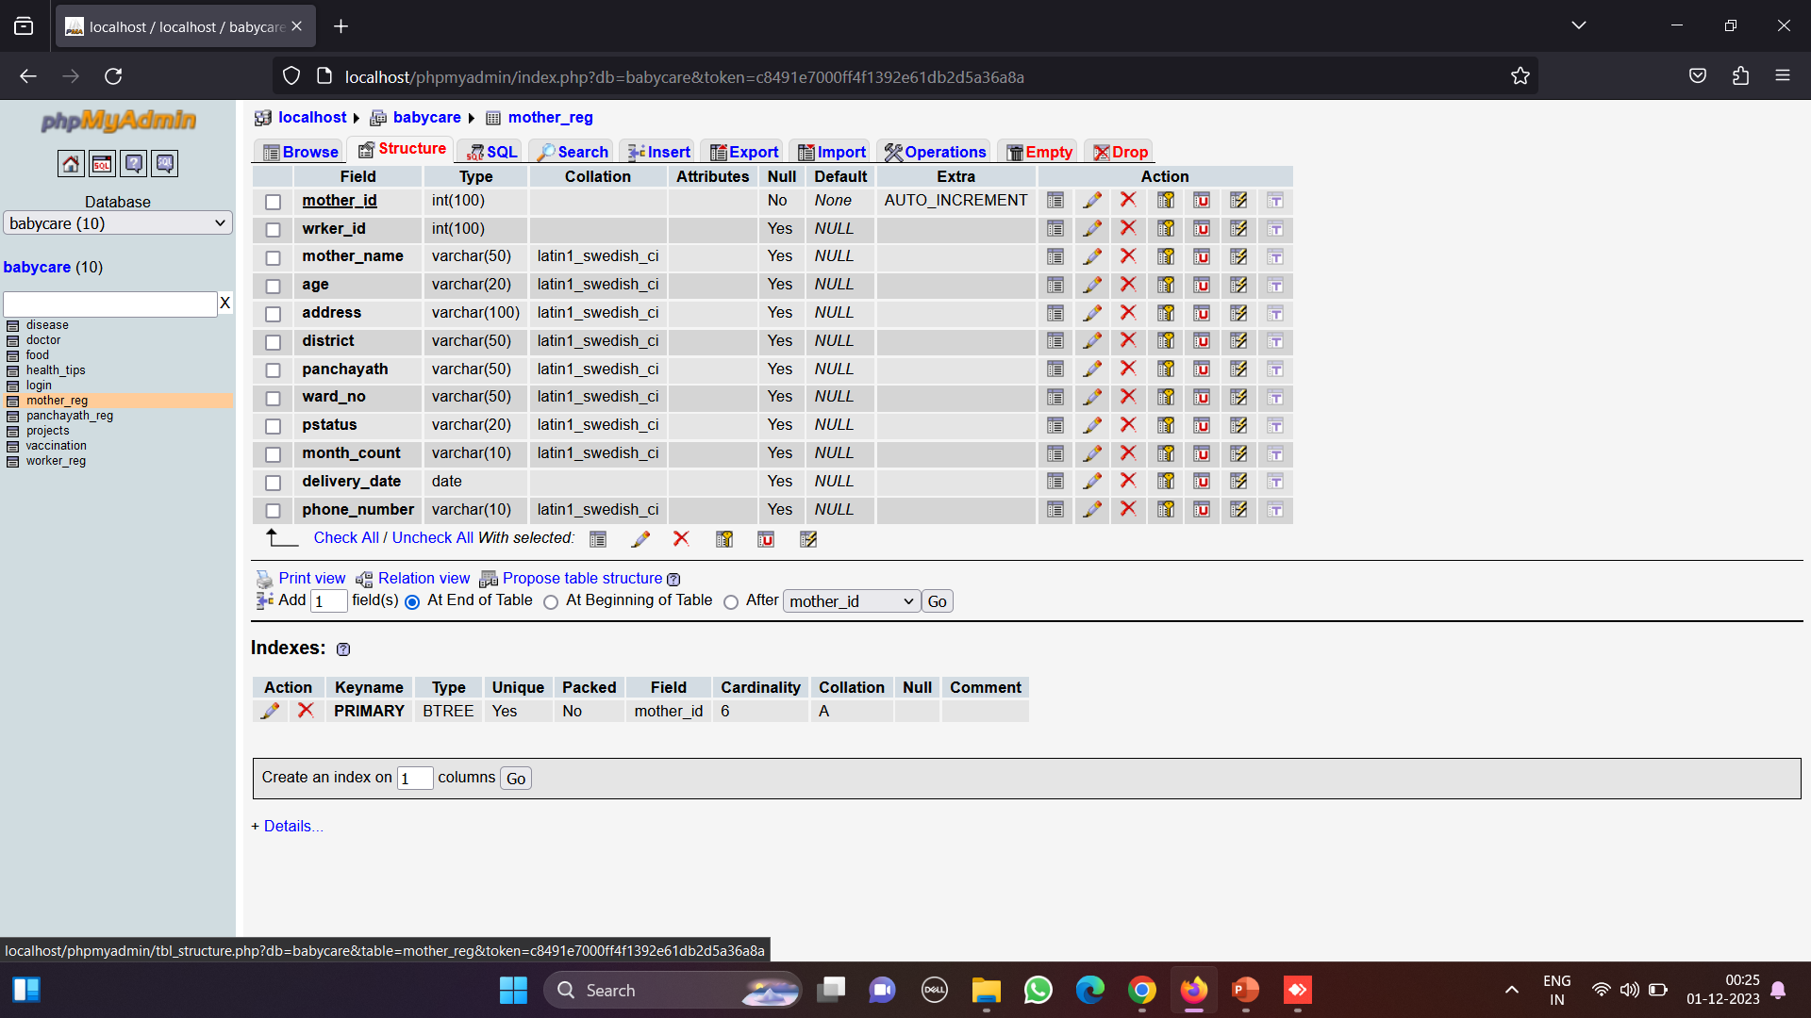
6.Table name:mother_reg

Slide 28
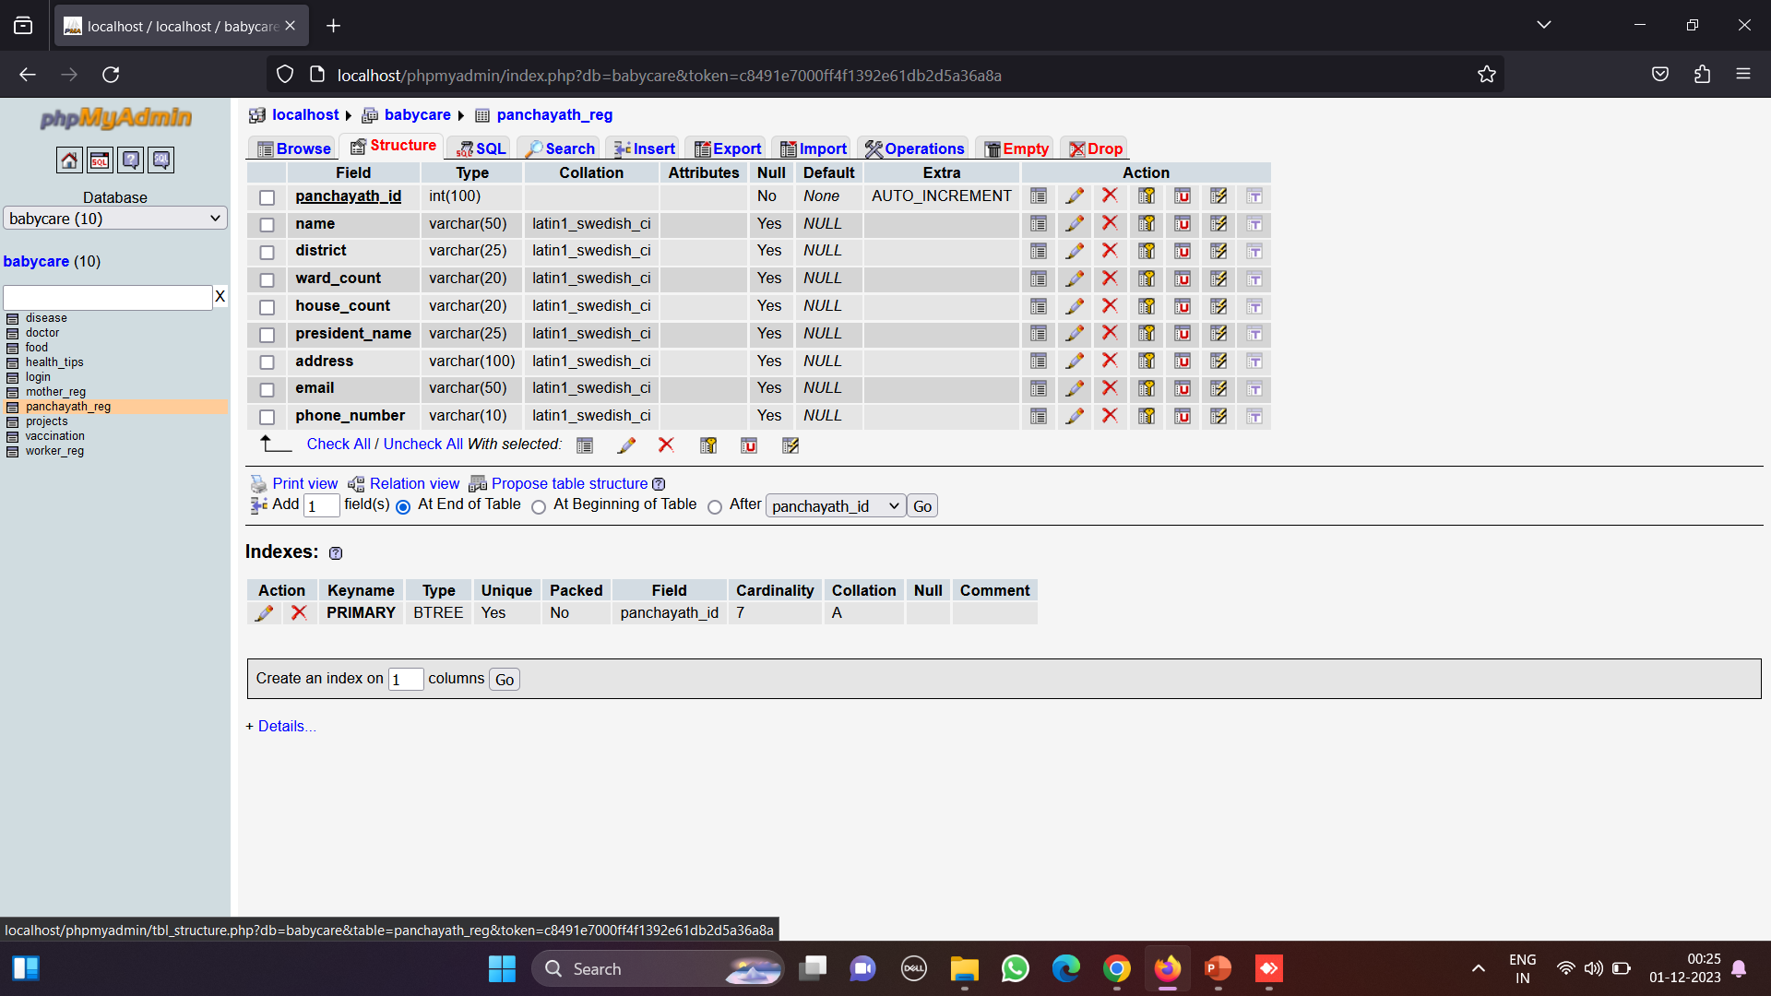
7.Table name:panchayath_reg

Slide 29
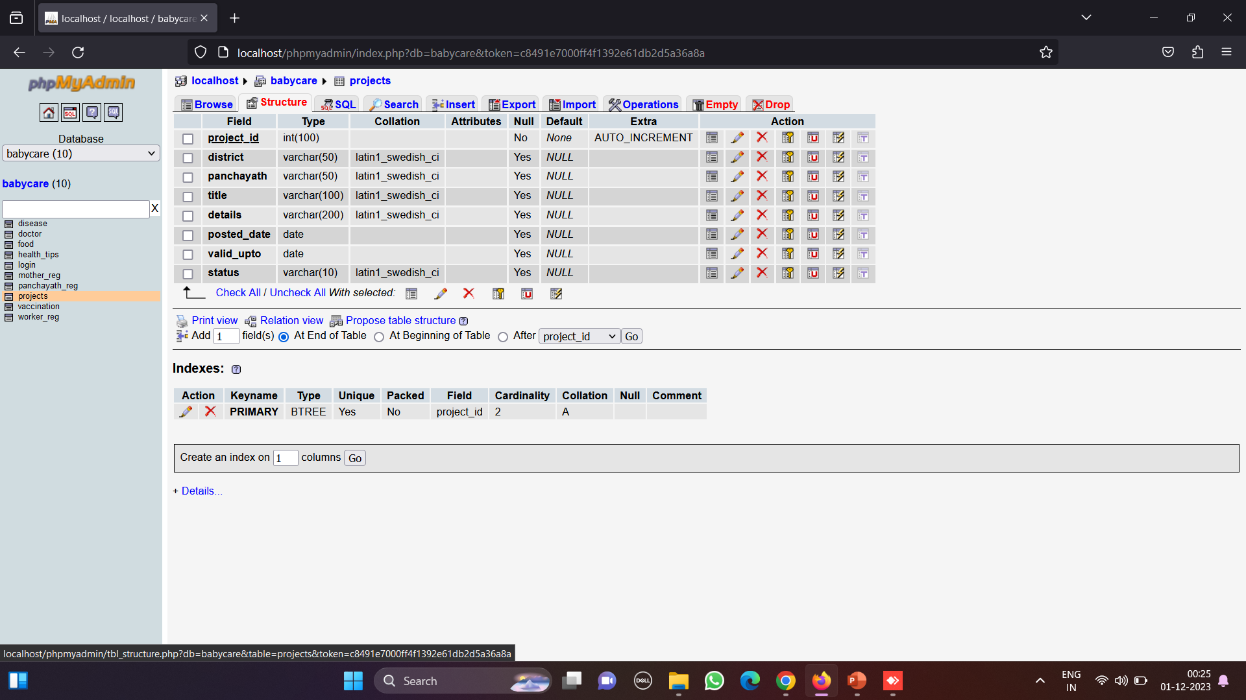
8.Table name:projects

Slide 30
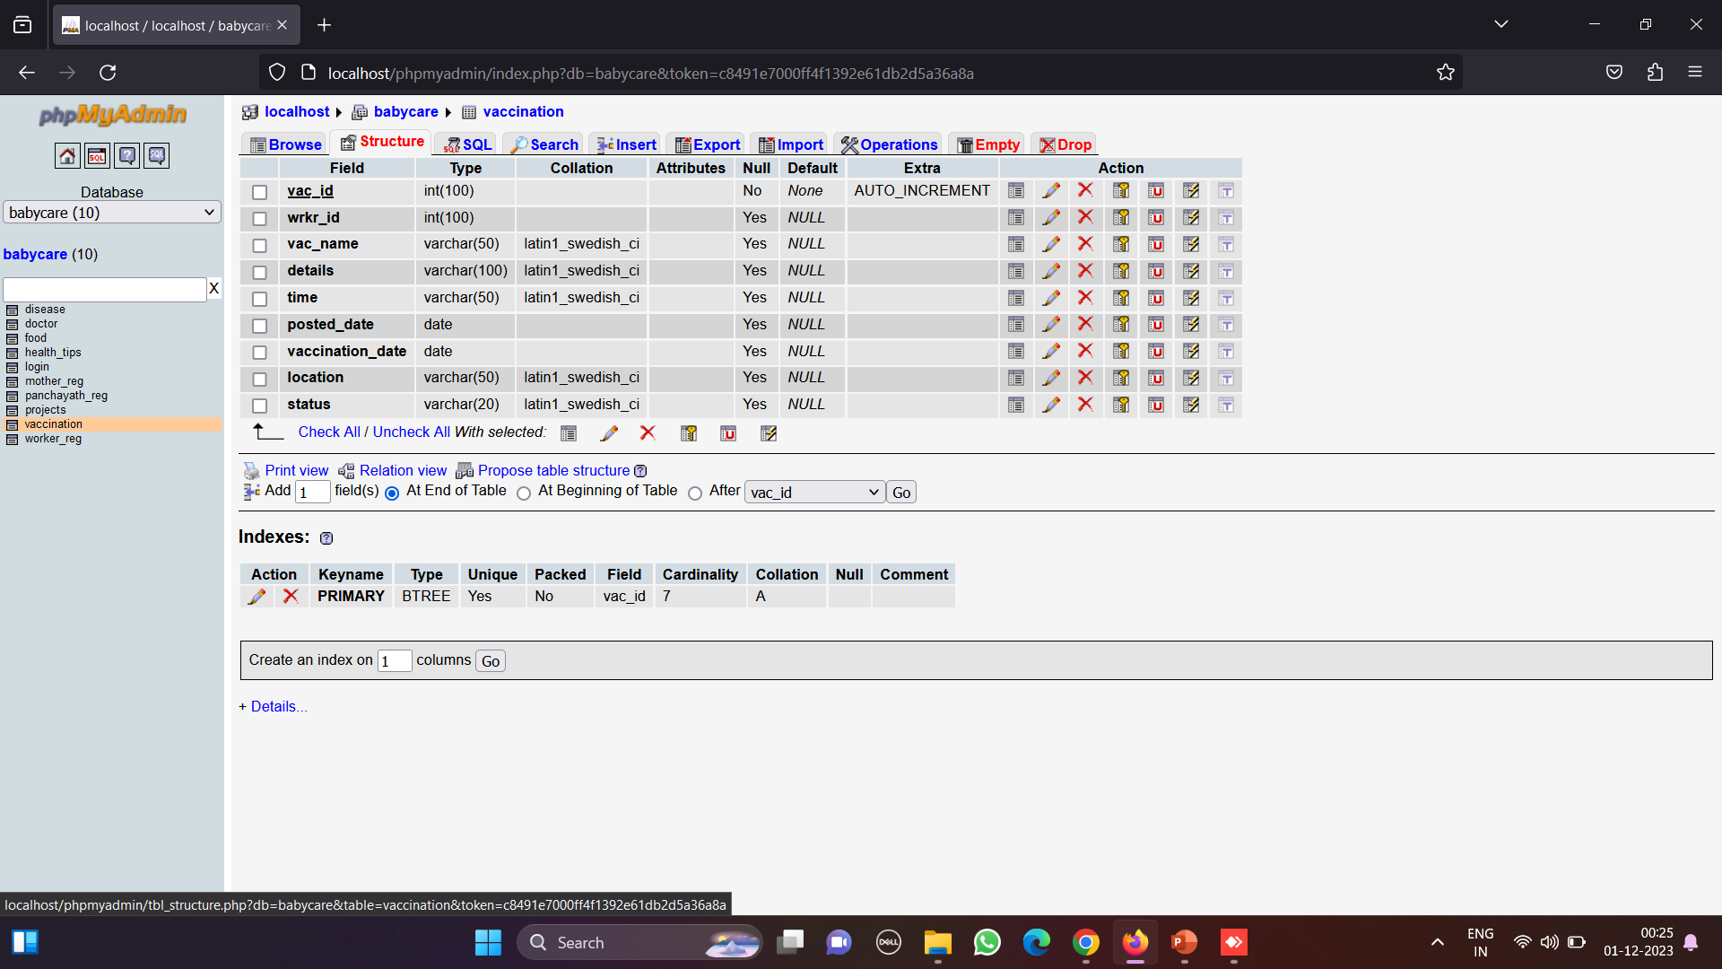
9.Table name:vaccination

Slide 31
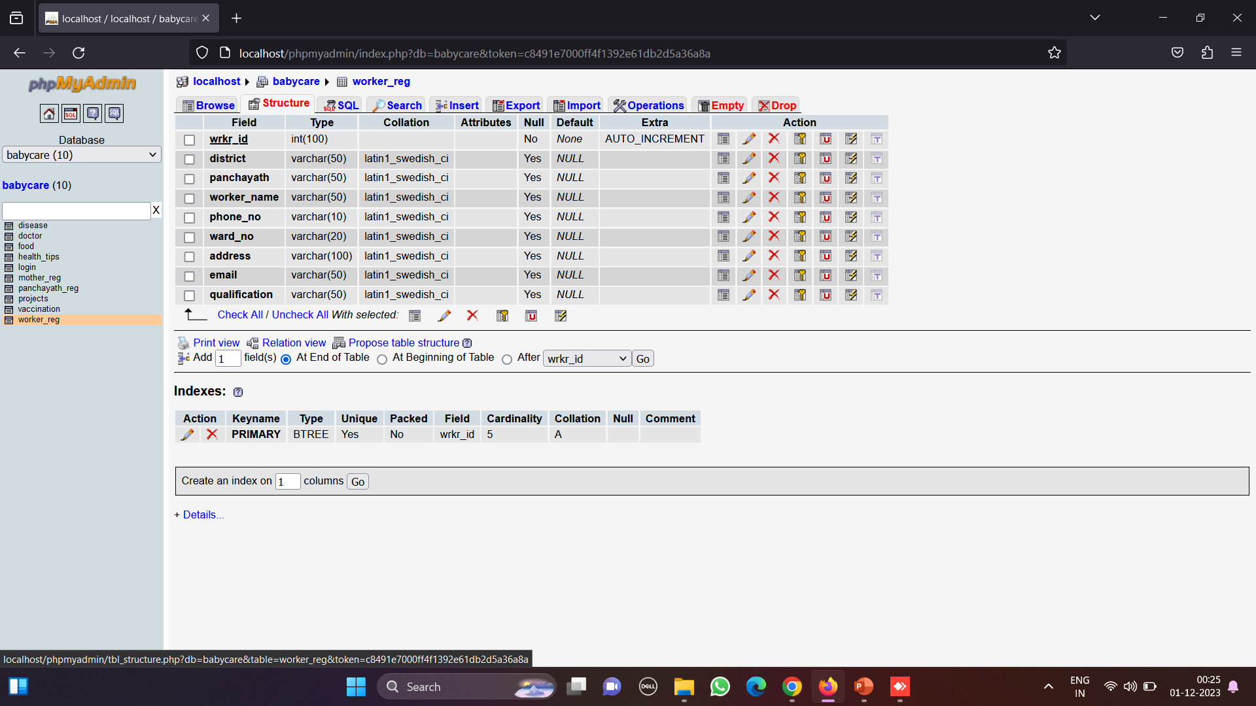
10.Table name:worker_reg

Slide 32
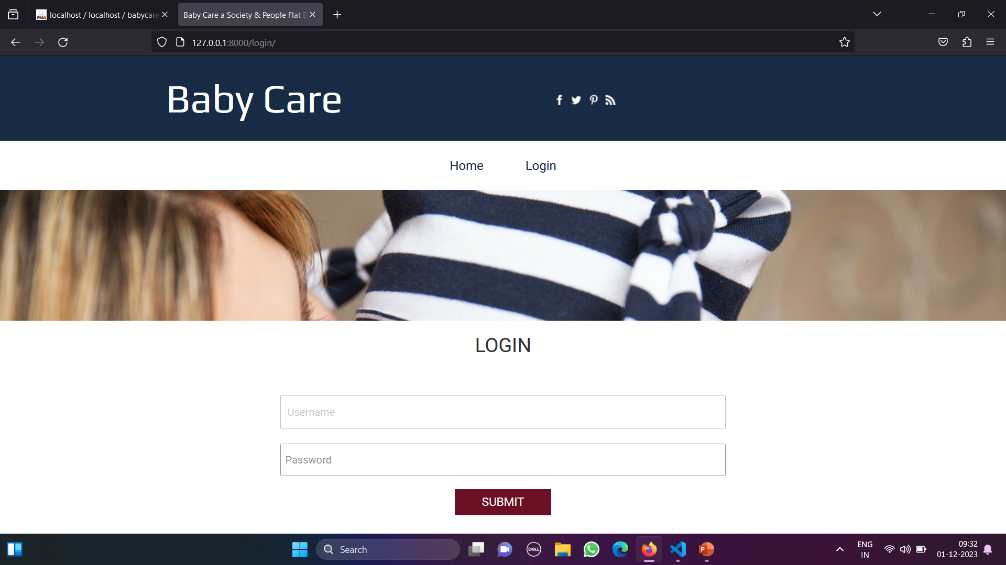
Screenshorts Home page

Slide 33
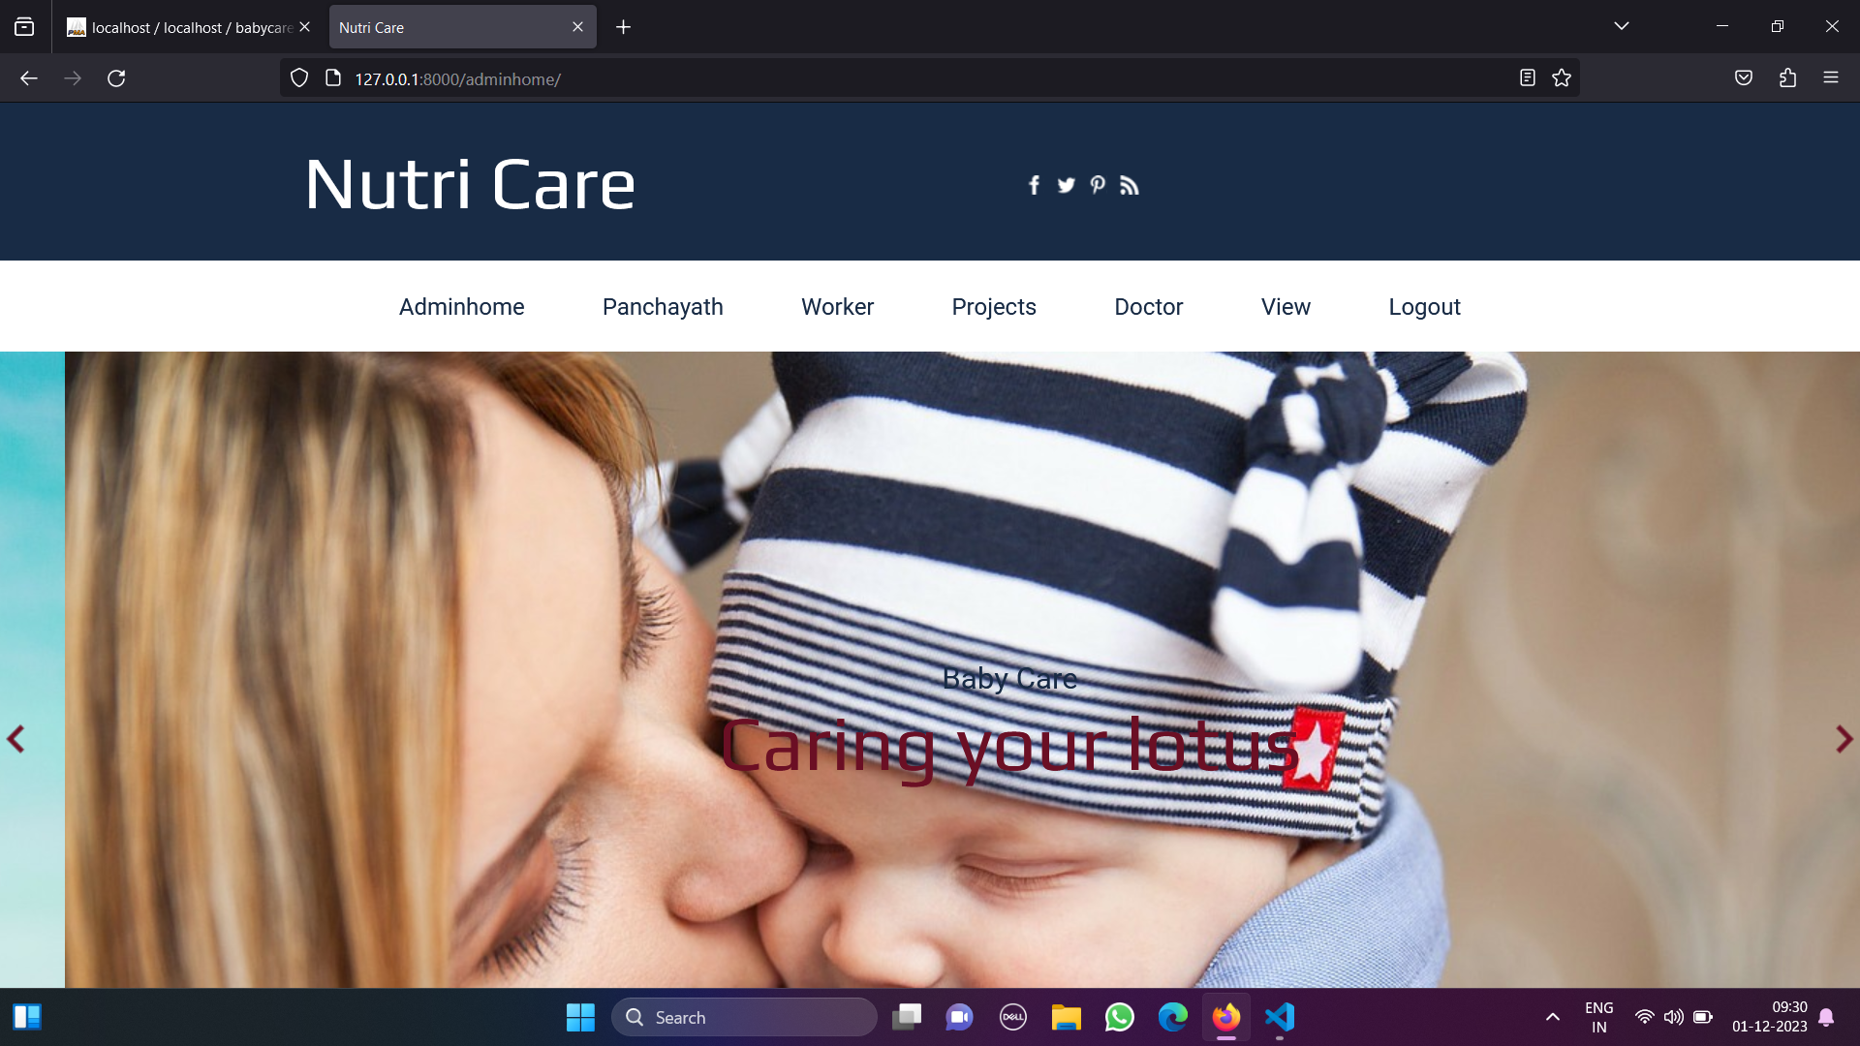
Login page

Slide 34
Future Enhancement
Enhancements are the prequistic for development of a system.
We can add video call consultancy by doctors in future.
As a future enhancement,the major advantage of the system is:
1.Reduced workload
2.Reduced paperwork
3.Provide security
4.Time saving

Slide 35
Conclusion
Most of the requirements and every effort has been done.
Implemented and tested successfully.
Provide maximum security and user friendly.
User with minimum knowledge about computer can also operate the system easily.

Slide 36
Thankyou

